Slide 1
PRESENTED BY T.PURNIMA
SAI
SARASWATHI TEAM
TEAM MEMBERS:
Vineet Begwani
V Divya sai teja
T . venkatlaXmi
Uditkumar .D

Slide 2
Welcome
to
Bata

Slide 3

Part 1: Brand study, Competitor Analysis & Buyer’s/Audience’s Persona
COMPANY /TOPIC FOR PROJECT:BATA
Research Brand Identity
In this activity you will be working on the Study the brand's mission, values, vision, and unique selling propositions (USPs).
Brand colors: Red color
Logo:
Mission/Values:
Bata India Mission Statement:
To be successful as the most dynamic, flexible and market responsive organization, with footwear as its core business.
Bata India Vision Statement:
To grow as a dynamic, innovative and market driven domestic manufacturer and distributor, with footwear as our core business, while maintaining a commitment to the country, culture and environment in which we operate.

Slide 4
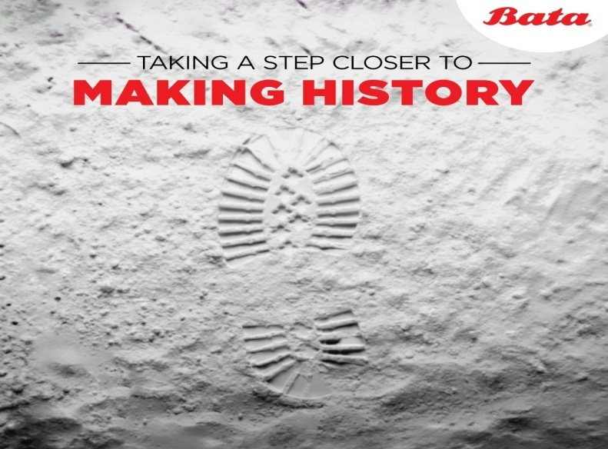

Part 1: Brand study, Competitor Analysis & Buyer’s/Audience’s Persona
Bata India Values: Management, Commitment, Environment
USP: Bata brand offers innovation and trust Brand Messaging:
Bata believes in pushing boundaries, in going the extra mile…
Example:
COMPANY /TOPIC FOR PROJECT:BATA
Examine the brand's tagline: Must have shoes. Everyday comfort.

Slide 5
Part 1: Brand study, Competitor Analysis & Buyer’s/Audience’s Persona
COMPANY /TOPIC FOR PROJECT:BATA
Competitor Analysis
In this activity you will be working on the competitor analysis by selecting three competitors operating in the same industry or niche as the chosen brand, examine their USPs and online communication. Competitor 1:https://www.campusactivewear.com/
USP: Categorisation,Creative,Personalised stylish shoes
Communication:Styling tips,user Genrated content,Relateable content
Competitor 2:https://www.relaxofootwear.com/
USP: Wide variety of products, Brand ties, Collaborations
Communication:Value based content,Tips,Celebrity endorsement
Competitor 3:https://www.khadims.com/
USP: Interactive website,Sale/cashback and offers,All round sale
Communication:Attractive memes,Information based content.

Slide 6
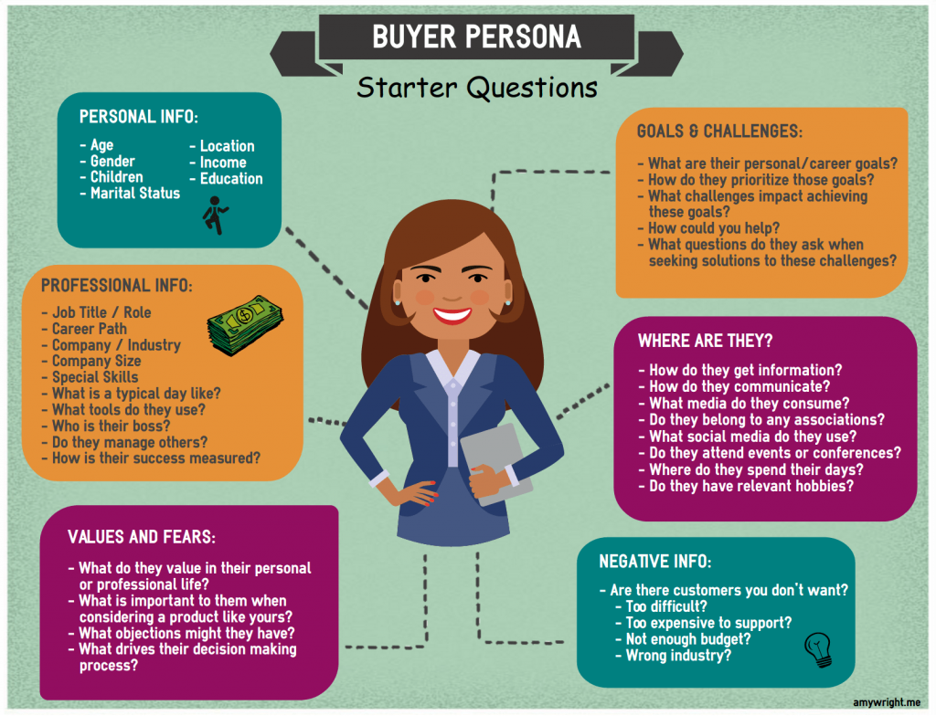
Part 1: Brand study, Competitor Analysis & Buyer’s/Audience’s Persona
Buyer's/Audience's Persona
In this activity you will be working on Buyer's/Audience's Persona by defining the target audience for the chosen brand. Consider demographics, psychographics, behaviors, and interests.
Brand:Bata
Age:5-50
Gender:Men and Women
Children:yes
Martial status:married/unmarried
Location:All over india
Income: Middle class,upper-class, high-income individuals
Education: Not considered
Source of information:Ads,youtube,instagram,billboard holdings and etc

Slide 7
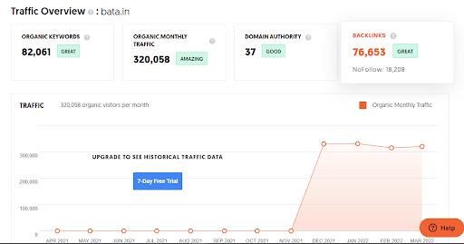
Part 2 : SEO & keyword research
SEO Audit on Bata:

Slide 8
Keyword research:
Keyword | position | Total searches | Estimated traffic
new | 80 | 6,120,000 | 12,852
bataindia | 1 | 27,100 | 8,238
power shoes | 1 | 22,200 | 6,748
formal men's shoes | 7 | 246,000 | 6,297
formal men's shoes | 7 | 246,000 | 6,297

Slide 9
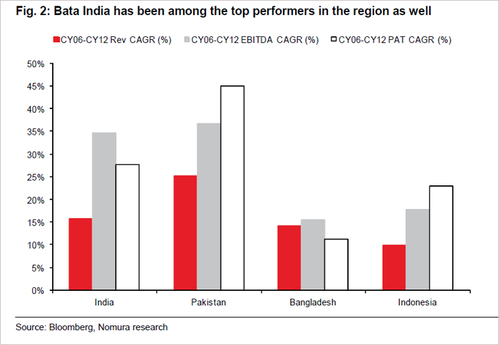
Analysis of Competitor Keywords:

Slide 10
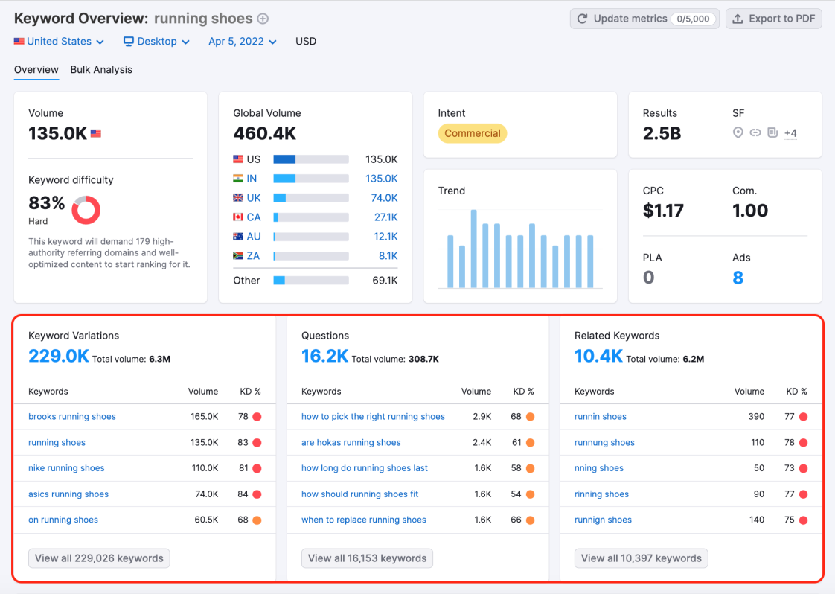
Keyword research Tool :
To expand physically, Bata India is all set to adopt asset-light franchise. After the recently concluded annual general meeting (AGM), it was decided that 80 per cent of its physical store expansion will be undertaken through the route of the franchise

Slide 11
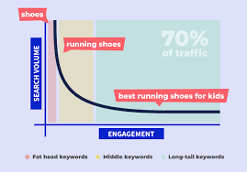
Long tail keywords:
From a one-man cobblers' operation in 1894, the Bata Shoe Company has grown to became one of the world's leading shoe manufacturing and retailing companies, with a retail network spanning across more than 70 countries.

Slide 12

On page optimization:
Meta Tag optimization & content optimization:
Footwear major Bata India will focus on expansion in small towns and online channels as part of its efforts to save cash through enhanced productivity, cost-reduction and tight inventory management to overcome the challenges of the pandemic, according to its annual report for 2020-21.
The company has adopted 'Survive, Revive, Revitalise and Thrive' strategy and is constantly monitoring the store level performance, driving sales through online channels and cost optimisation across all functions.
Meta description for SEO:
A meta description is an attribute within your meta tags that helps describe your page. This snippet of text may appear in the search engine results under your headline, though sometimes, search engines will pull a snippet of text from the main body copy of the page instead

Slide 13

Content optimization for SEO :
Essentially, content optimization, or SEO (search engine optimization), is the process of optimizing your content to make sure that it's more visible through the web. Search engine robots will rank highly optimized content higher on a search engine page than non-optimized content.
Tips and techniques how to optimize:
Defining objectives. It's vital to specify the goal to be accomplished before any adjustments are made. ...
Mapping current processes. ...
Eliminating redundant or expendable steps. ...
Rethinking processes. ...
Implementing automation tools. ...
Continuously monitoring results.

Slide 14
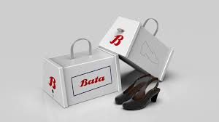
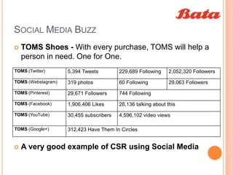
Part 3 : content ideas and marketing strategies:
To expand physically, Bata India is all set to adopt asset-light franchise. After the recently concluded annual general meeting (AGM), it was decided that 80 per cent of its physical store expansion will be undertaken through the route of the franchise.

Slide 15
Content calender:
Bata - July 2023 Monthly Content Calendar
Week 1: July 1st - July 9th
Theme: "Summer Shoe Collection"
July 1st: "Step into Summer with Bata's New Collection!" - Introduce the latest summer shoe collection in a blog post on the website.
July 3rd: "Beach Ready Footwear" - Showcase flip-flops, sandals, and water-friendly shoes on social media with stunning beach imagery.
July 6th: "Customer Spotlight: Your Summer Adventures" - Share user-generated content featuring customers wearing Bata shoes on their summer adventures.
July 9th: "Comfort and Style for Your Summer Wardrobe" - Create a video highlighting how Bata shoes combine style and comfort for the season.
Step 1: Start your template. First, head to Excel and start a blank template. ...
Step 2: Date and Day. ...
Step 3: Post Topic. ...
Step 4: Image. ...
Step 5: Content Pillar. ...
Step 6: Platform.

Slide 16
Week 2: July 10th - July 16th
Theme: "Sustainable Footwear"
July 10th: "Our Sustainable Journey" - Publish an article detailing Bata's commitment to sustainability and eco-friendly shoe materials.
July 12th: "Recycling Program Announcement" - Announce a new initiative for customers to recycle their old shoes at Bata stores.
July 14th: "Behind the Scenes: Green Manufacturing" - Take followers on a virtual tour of a Bata eco-friendly manufacturing facility.
July 16th: "Walking Towards a Greener Future" - Encourage followers to share their eco-conscious efforts, using a dedicated hashtag.

Slide 17
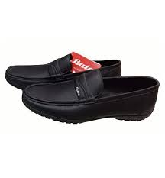
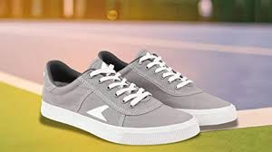
Week 3: July 17th - July 23rd
Theme: "Bata's Shoe Care Tips"
July 17th: "The Ultimate Shoe Care Guide" - Share a comprehensive blog post on how to care for different types of shoes.
July 19th: "Cleaning Hacks for White Sneakers" - Create a short video demonstrating easy tips to keep white sneakers pristine.
July 21st: "Revive Your Old Favorites" - Showcase before-and-after images of rejuvenated shoes after using Bata's shoe care products.
July 23rd: "Q&A with Our Shoe Care Experts" - Host a live Q&A session on social media with Bata's shoe care experts.

Slide 18
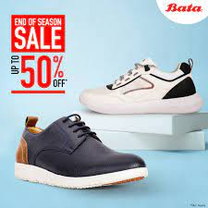
Week 4: July 24th - July 31st
Theme: "Bata's Back to School Collection"
July 24th: "Back to School Fashion Must-Haves" - Highlight Bata's latest school shoes and accessories in a fashion blog post.
July 26th: "Shoe Shopping Made Easy" - Share a video featuring the convenience of shopping for school shoes online or in-store.
July 28th: "Win a Back to School Shopping Spree!" - Launch a social media contest, giving customers a chance to win a shopping spree.
July 31st: "Last Chance: Back to School Sale Ends Today" - Create urgency with a reminder about the final day of the back-to-school sale.
Bata India (@bata.india)

Slide 19

PART 4 : CONTENT CREATION AND CURATION :
Format 1

Slide 20
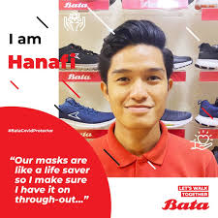
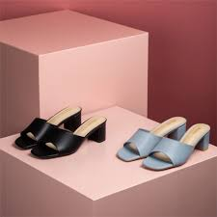
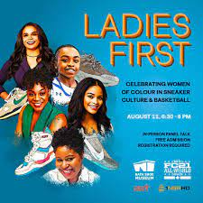

Format 2

Slide 21


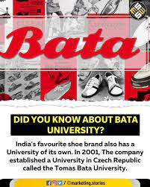

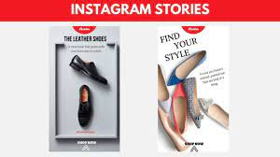
Format 3

Slide 22

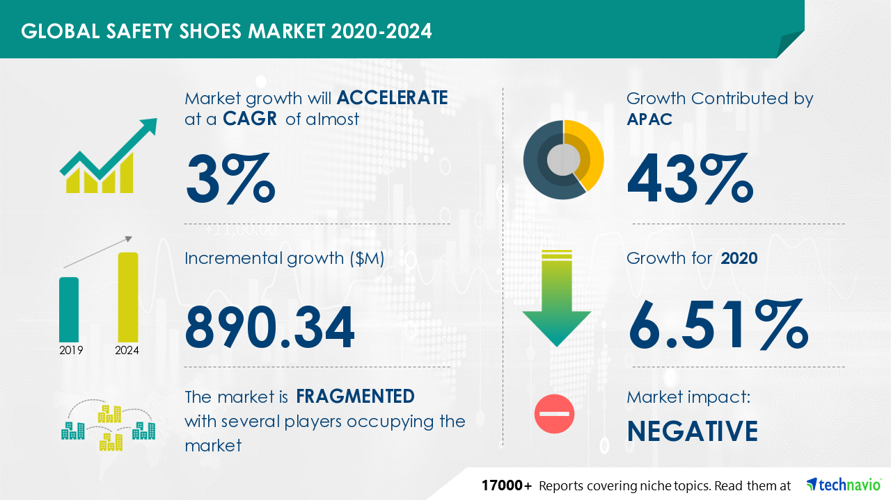
INSIGHT TOOL ANALYSE

Slide 23
Strategies and Areas for improvement
Market Penetration Strategy. When a firm focuses on selling its current products to existing customers, it is pursuing a market penetration strategy. ...
Market Development Strategy. ...
Product Development Strategy. ...
Diversification Strategy.
These seven are: product, price, promotion, place, packaging, positioning and people. As products, markets, customers and needs change rapidly, you must continually revisit these seven Ps to make sure you're on track and achieving the maximum resul ts possible for you in today's marketplace.
strategies that make up organic growth. These strategies are known as market penetration, market development, product development, and diversification. Market Penetration: This growth strategy involves selling more of a company's existing products or services to its current customer base.

Slide 24

Social media Ad campaign:

Slide 25
Advertising goals :
Brand awareness:
Brand awareness refers to the familiarity of consumers with a particular product or service. A brand awareness campaign seeks to familiarize the public with a new or revised product and differentiate it from the competition. Social media has become an important new tool in brand awareness marketing.
Driving website traffic:
Aims to build familiarity and name recognition so that potential customers will think of the brand when they are ready to make a purchase. Here are some tactics on how to build brand awareness from scratch. Use a mix of these tactics to reach the broadest audience possible.
Generating leads:
Lead generation is process of generating consumer interest for a productt or service with the goal of turning that interest into a sale. In online marketing this typically involves collecting a visitor’s contact information via a web form.

Slide 26

Audience targeting:
Bata being the mother brand covers all these segments in their portfolio. Target: Target customer of Bata includes Price conscious middle-class families, youth looking for affordable & trendy products. It targets all the age groups & has something for every member of the family, i.e. men, women & kids.
Attracting visitors to the dealer's new online store. 1. Allocating target audience for the campaign: male and female users aged 20 and over, sports enthusiasts, upper-middle-class segment.

Slide 27


Email Ad campaign 1 :Brand Awareness:

Slide 28
Email Ad Campaign 2 –Lead Generation :

Slide 29
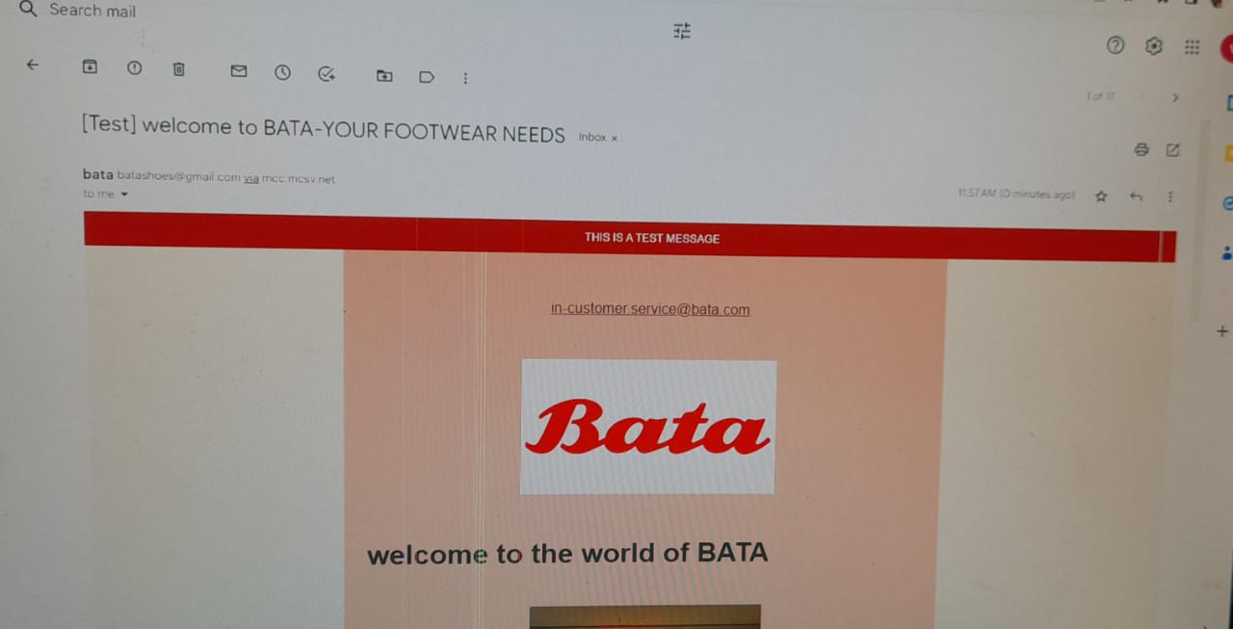
Email Ad Campaign 3: Generation lead:

Slide 30
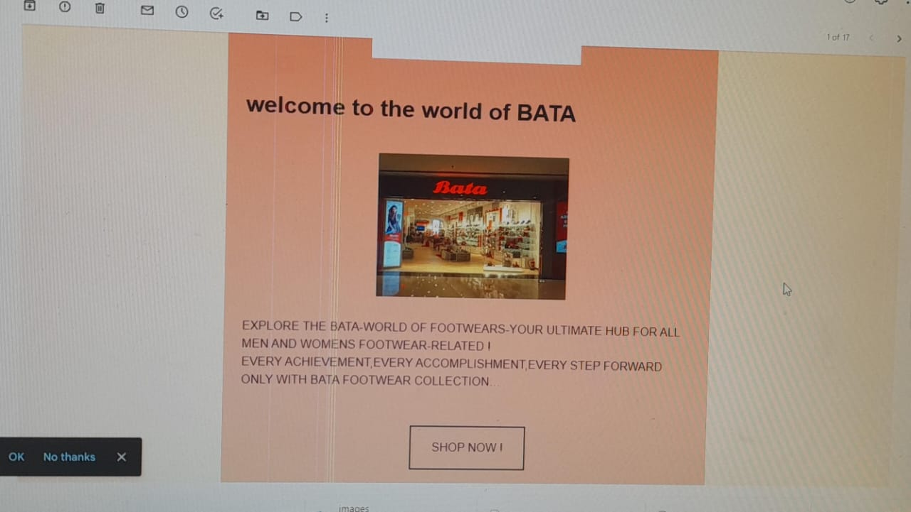
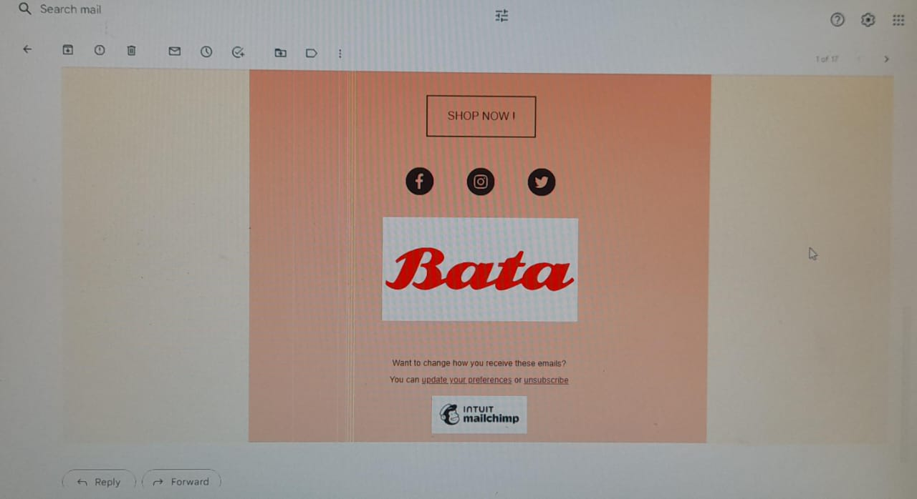

Slide 31
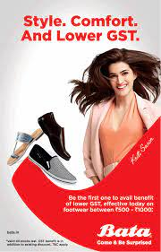
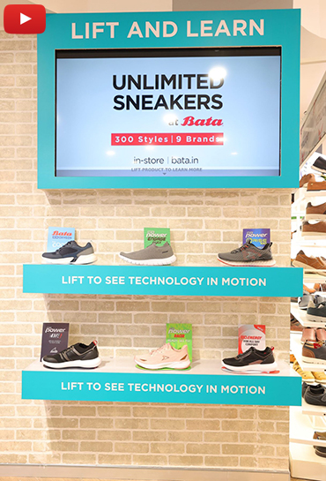
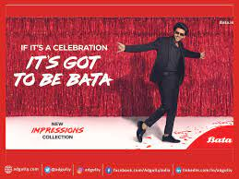
Visually appealing ad compelling ad copy and relevant call to action

Slide 32



